Slide 1
Mathematical modeling of COVID-19 in 14.8 million individuals in Bahia, Brazil
Juliane F. Oliveira, Daniel C. P. Jorge, Rafael V. Veiga, Moreno S. Rodrigues, Matheus F. Torquato, Nivea B. da Silva, Rosemeire L. Fiaccone, Luciana L. Cardim, Felipe A. C. Pereira, Caio P. de Castro, Aureliano S. S. Paiva, Alan A. S. Amad, Ernesto A. B. F. Lima, Diego S. Souza, Suani T. R. Pinho, Pablo Ivan P. Ramos & Roberto F. S. Andrade
Presenter: Ching-Shun Wu
Group Member: Yu-Heng Lin
Instructor: An-Chi Wei

Slide 2
Outline
Introduction
Method
SEIIHURD Model
Model Construction
Results
Simulations
Model Reproduction
Comparison with SIR (agent-based model)
Conclusion

Slide 3
Introduction

Slide 4
Introduction
The rapid spread of Covid-19 and the lack of proper treatment and even clinical severity make it unique.
Therefore, this paper provides insight into the dynamics of disease transmission by using a compartment model and expands the number of compartments established to 8 to study other key aspects of COVID-19, considering the Asymptomatic/mild, hospitalization of severe cases Treatment (clinical/ICU bed required) and mortality.
Notes:
Tumor burden Refers to the number of cancer cells, the size of a tumor, or the amount of cancer in the body.
A type of clinical trial that tests how well a new drug or other substance works in patients who have different types of cancer that all have the same mutation or biomarker.

Slide 5
Methods

Slide 6
Methods - Data Resource
The data source used for this study is the daily series of cumulative confirmed COVID-19 cases in Bahia, its capital Salvador and the remaining interior cities(416) and the daily mortality series from public data provided by the Minister of Health of the State of Bahia, which also provided state-level daily bed occupancy rates for clinical and ICU beds.
https://www.cancer.gov/publications/dictionaries/cancer-terms/def/immune-checkpoint-inhibitor
Notes:
Checkpoint proteins, such as PD-L1 on tumor cells and PD-1 on T cells, help keep immune responses in check.
The binding of PD-L1 to PD-1 keeps T cells from killing tumor cells.
Blocking the binding of PD-L1 to PD-1 with an immune checkpoint inhibitor allows the T cells to kill tumor cells.

Slide 7
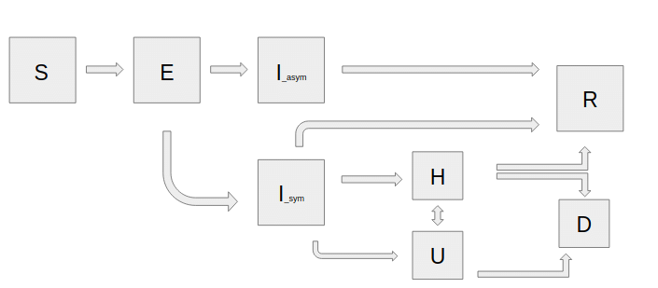
Methods – SEIIHURD Model
There are 8 compartments, susceptible population (S); exposed (E); recovered (R); death (D);asymptomatic /undetected infections(I) ; ICU admission (U) ; hospitalization (H).
(1)
Notes:
In words, equation (1) states that the change in tumor volume over time is due to the intrinsic growth of the tumor, reduced by the kill rate of cancer cells due to immunotherapy treatment, which is dependent on the ratio of initial tumor cells to immune cells, the number of immune cells required to kill one tumor cell and the efficacy of immune cell activation.

Slide 8

Method –Model Construction
where is a Heaviside step function, βi are transmission rates that can be obtained by the fitting of the data to the time interval defined by the t_{i}’s.

Slide 9
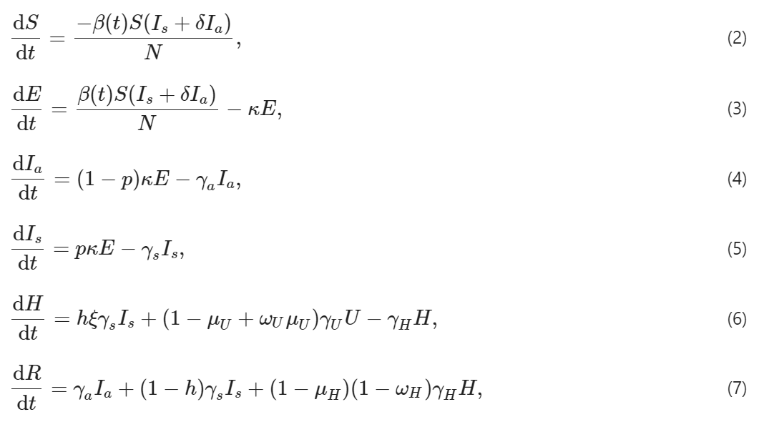
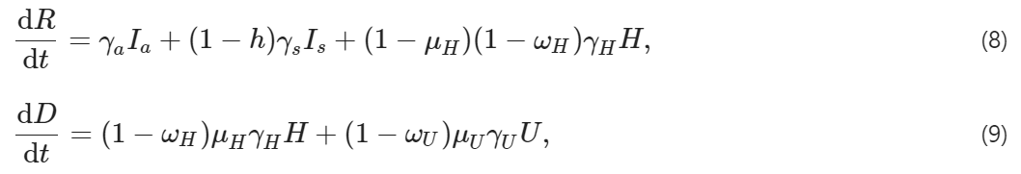
Method –Model Construction-parameters
Parameters | Description
N | Size of initial population.
β | Transmission rate that varies over time.
β0 | Pre-intervention transmission rate
β1 | Post-intervention transmission rate
δ | Asymptomatic/non-detected infectivity factor
κ | Mean exposed period, or incubation time (days−1 ).
p | Proportion of latent (E) that proceed to symptomatic infective.
γa | Mean asymptomatic period (days−1).
γs | Mean symptomatic period (days−1 ).
h | Proportion of symptomatic needing hospitalization or ICU (severe or critical cases).
1−ξ | Proportion of hospitalized symptomatic that proceed to ICU (critical cases).
γH | Mean hospitalization (clinical beds) period (days−1)
γU | Mean period in ICU (days−1).
μH | Death rate of individuals in general ward.
μU | Death rate of individuals in ICU.
ωH | Proportion of hospitalized that goes to ICU
ωU | Proportion of ICU that goes to hospitalization

Slide 10
Results

Slide 11
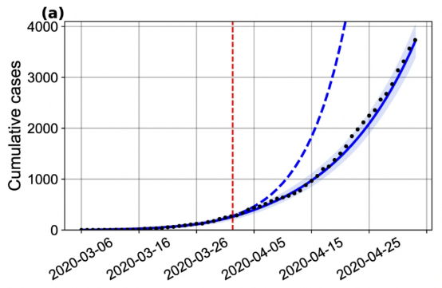
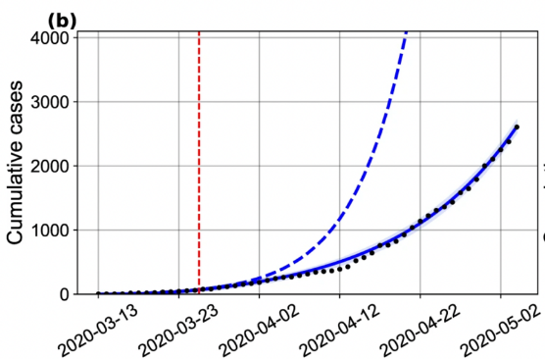
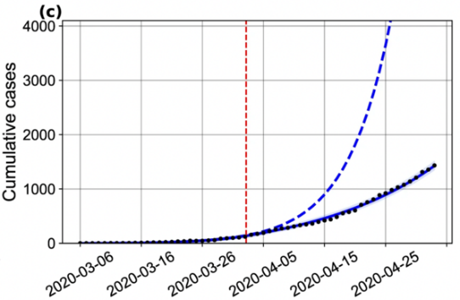
Result - The impact of social distancing and government intervention on disease transmission
This is the figure which shows projection of the number of cases with a changing transmission rate.
(a) in Bahia; (b) in Salvador, and (c) in the remaining 416 cities.
https://www.cancer.gov/publications/dictionaries/cancer-terms/def/immune-checkpoint-inhibitor
Notes:
Checkpoint proteins, such as PD-L1 on tumor cells and PD-1 on T cells, help keep immune responses in check.
The binding of PD-L1 to PD-1 keeps T cells from killing tumor cells.
Blocking the binding of PD-L1 to PD-1 with an immune checkpoint inhibitor allows the T cells to kill tumor cells.

Slide 12
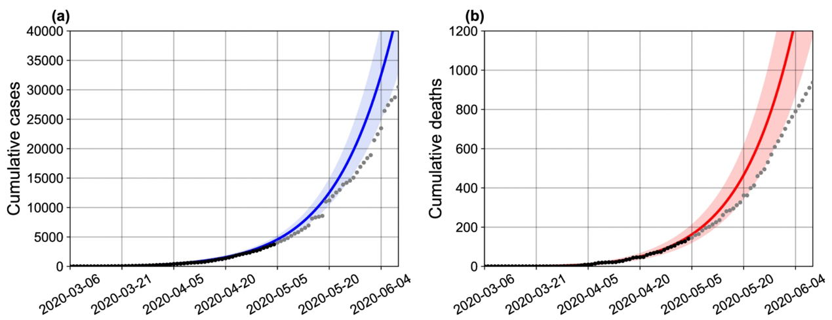
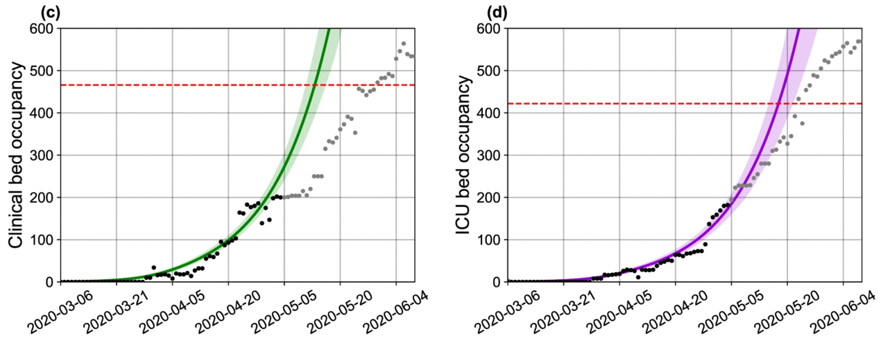
Result - Real-time modeling
Using the latest epidemiological data, the authors were able to compare the original predictions of the SEIIHURD model with COVID-19 in Bahia.
The original model's 30-day forecast (calibrated on May 4, 2020) predicted the number of reported cases, deaths, and ICU needs well, with actual values ​​falling within the confidence intervals of the authors' predictions
https://www.cancer.gov/publications/dictionaries/cancer-terms/def/immune-checkpoint-inhibitor
Notes:
Checkpoint proteins, such as PD-L1 on tumor cells and PD-1 on T cells, help keep immune responses in check.
The binding of PD-L1 to PD-1 keeps T cells from killing tumor cells.
Blocking the binding of PD-L1 to PD-1 with an immune checkpoint inhibitor allows the T cells to kill tumor cells.

Slide 13
Simulations

Slide 14
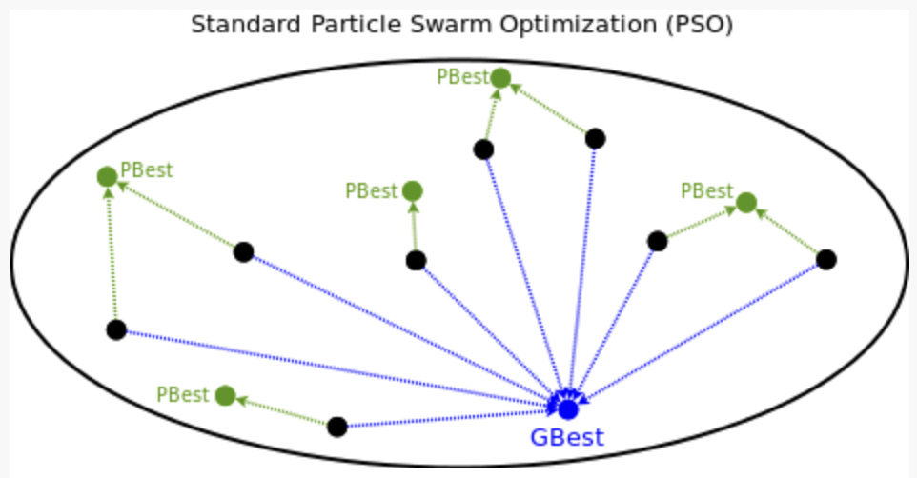
Simulation- Particle swarm optimization
PSO is a random search algorithm originally developed to graphically analogize the graceful and unpredictable movements of flocks of birds. PSO can effectively search for problems with huge solution space and find candidate solutions without knowing too much problem information, but at the same time, it does not guarantee that the best solution it finds is the real best solution.

Slide 15
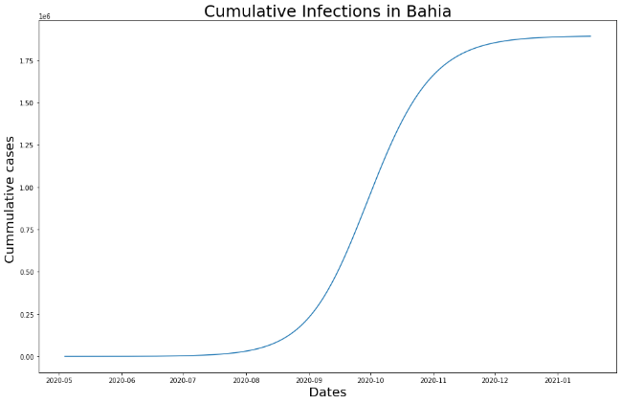
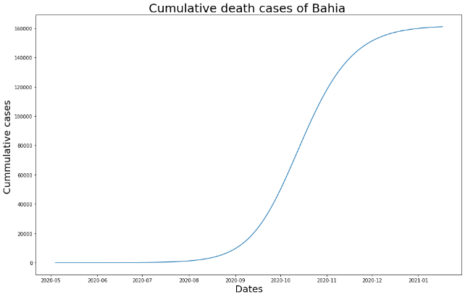
Simulation- Reproduce original model
This is the figure which shows cumulative infected cases and deaths cases in Bahia.

Slide 16
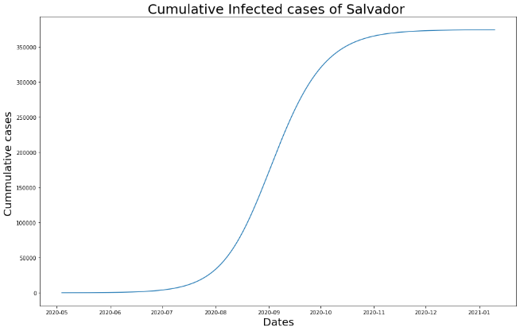
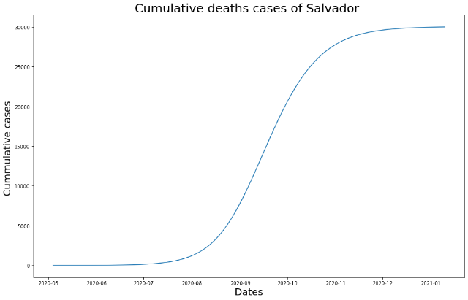
Simulation- Reproduce original model
This is the figure which shows cumulative infected cases and deaths cases in Salvador.

Slide 17

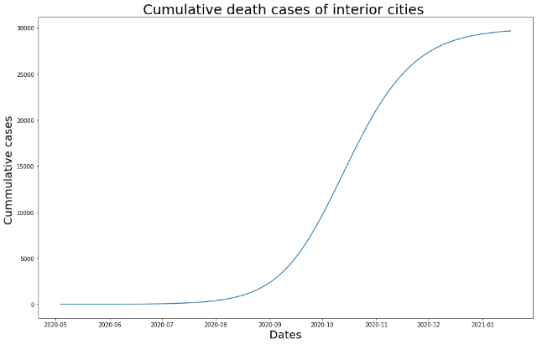
Simulation- Reproduce original model
This is the figure which shows cumulative infected cases and deaths cases in rest interior cities.

Slide 18
Discussion

Slide 19
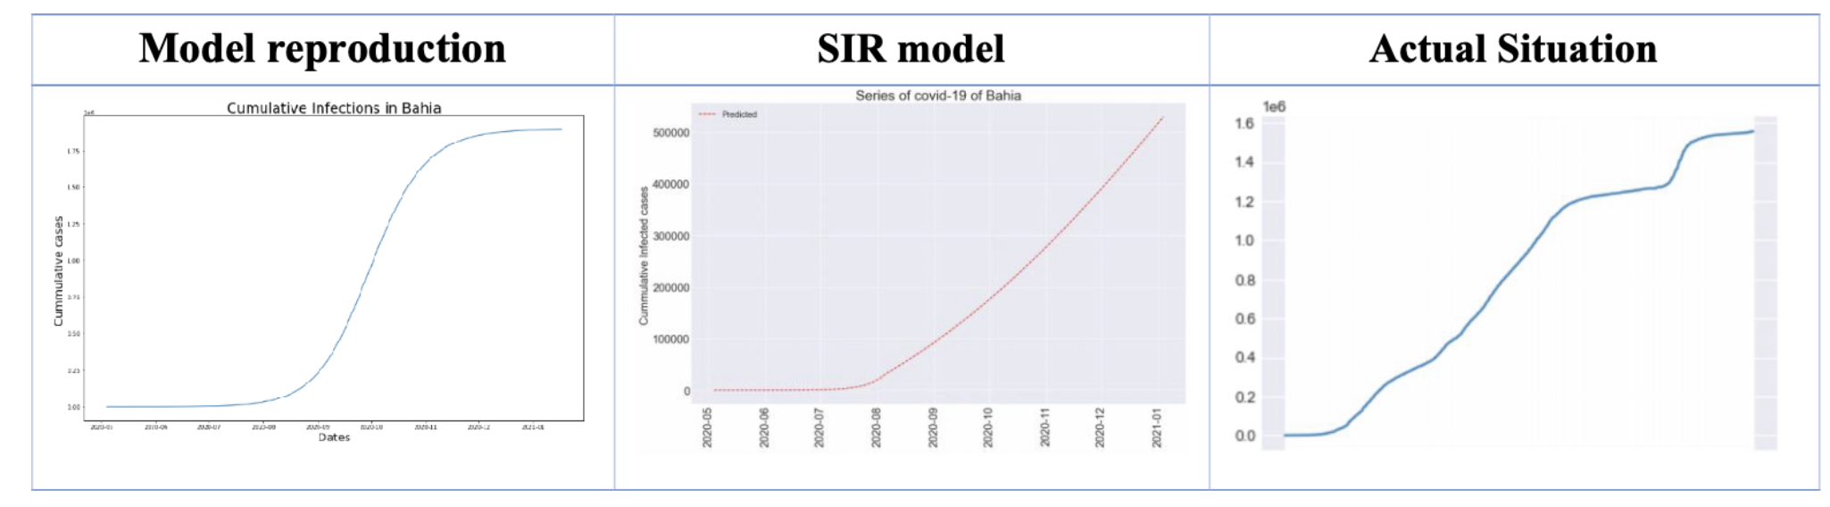
Discussion– Comparison
Notes:
Through making the substitutions.

Slide 20
Discussion– Conclusion
The results of this study show that the intervention of government quarantine orders will effectively reduce the rate of virus transmission.
This paper reinforces the negative impact of healthcare resources associated with the cycle of asymptomatic/mild cases.
The findings suggest that non-pharmaceutical measures should be implemented to reduce the rate of disease transmission to buy time for the creation of new hospitals, access to protective equipment and materials, and the safeguarding of human resources.
Notes:
Through making the substitutions.

Slide 21
Thank you for listening!

